Slide 1
File Transfer between local desktop to EC2 Linux Instance

Slide 2
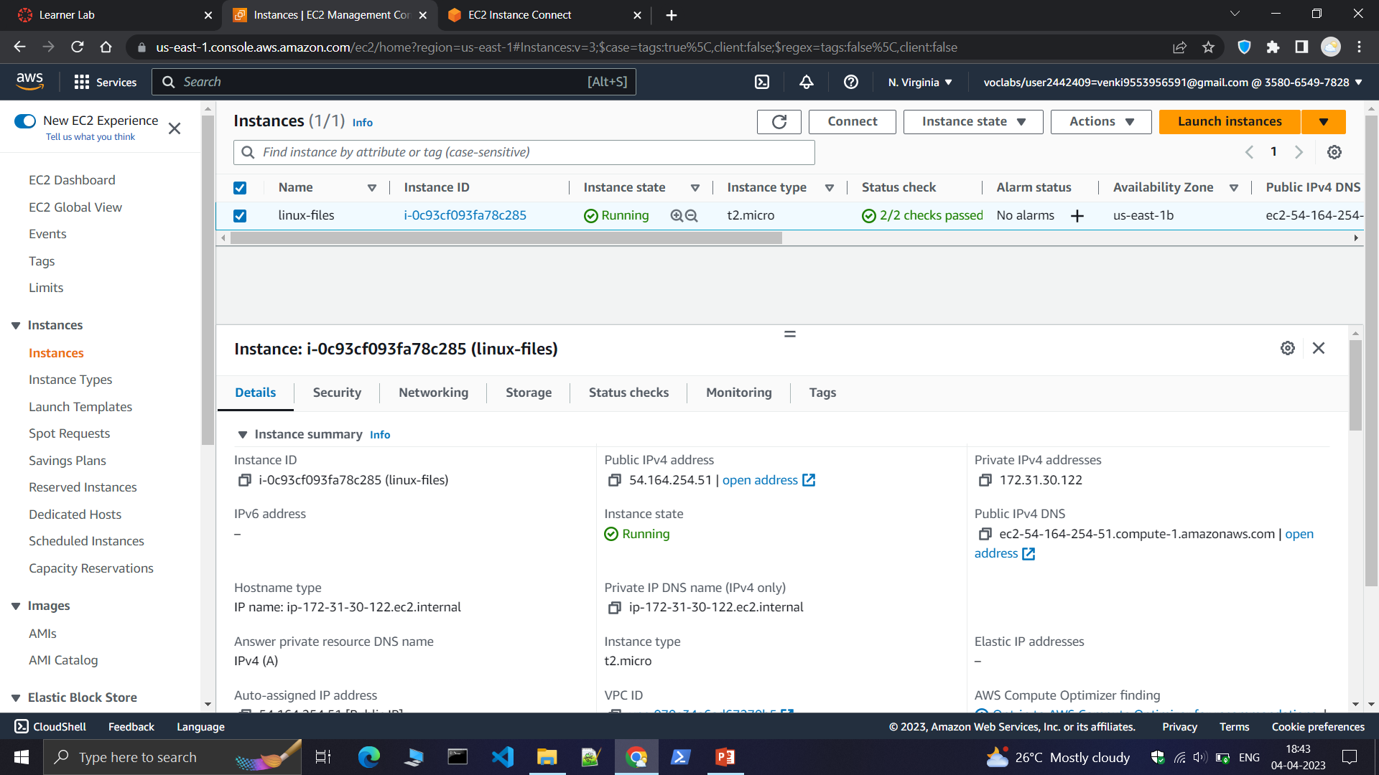
Step1:Create a Linux instance.

Slide 3
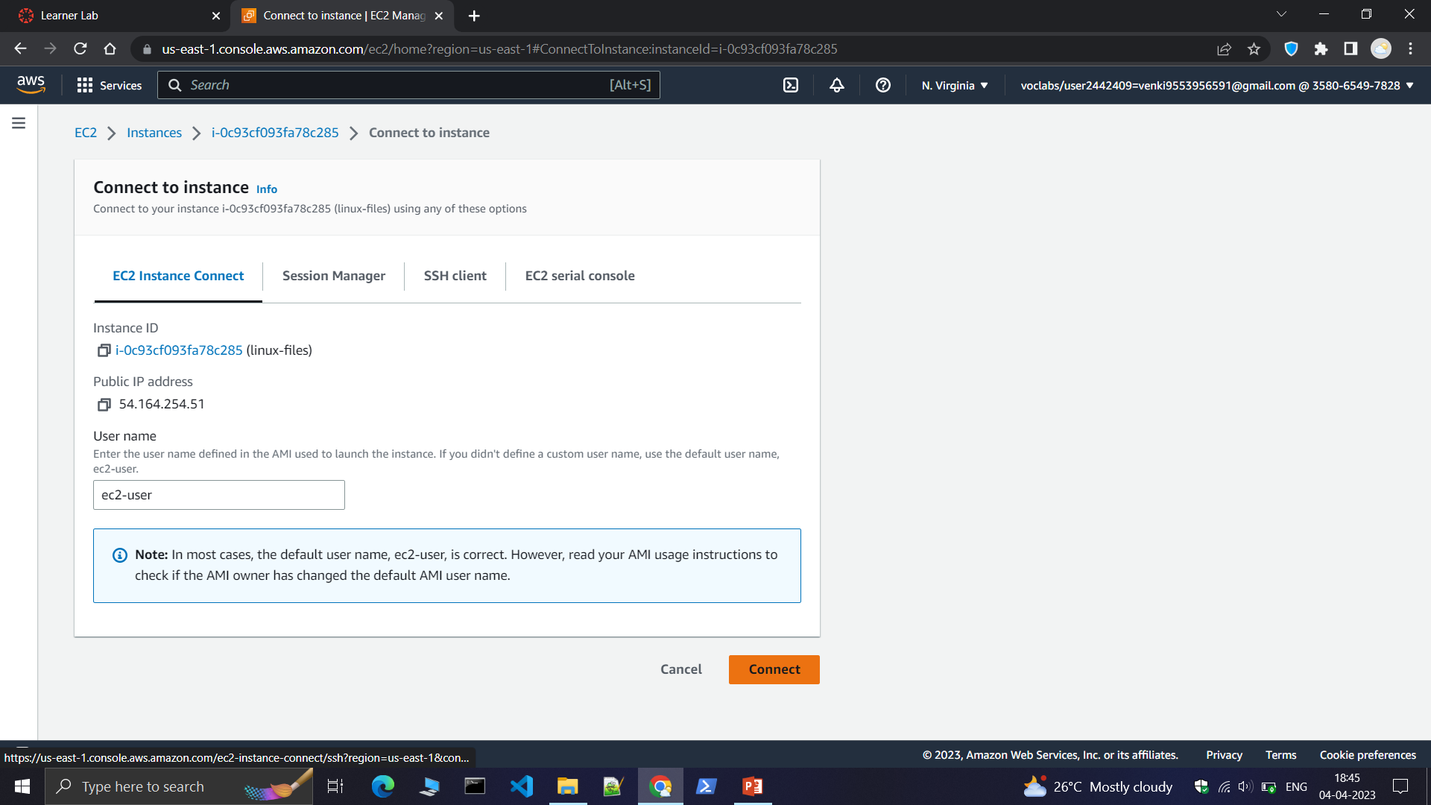
Step2:Connect to the linux instance.

Slide 4
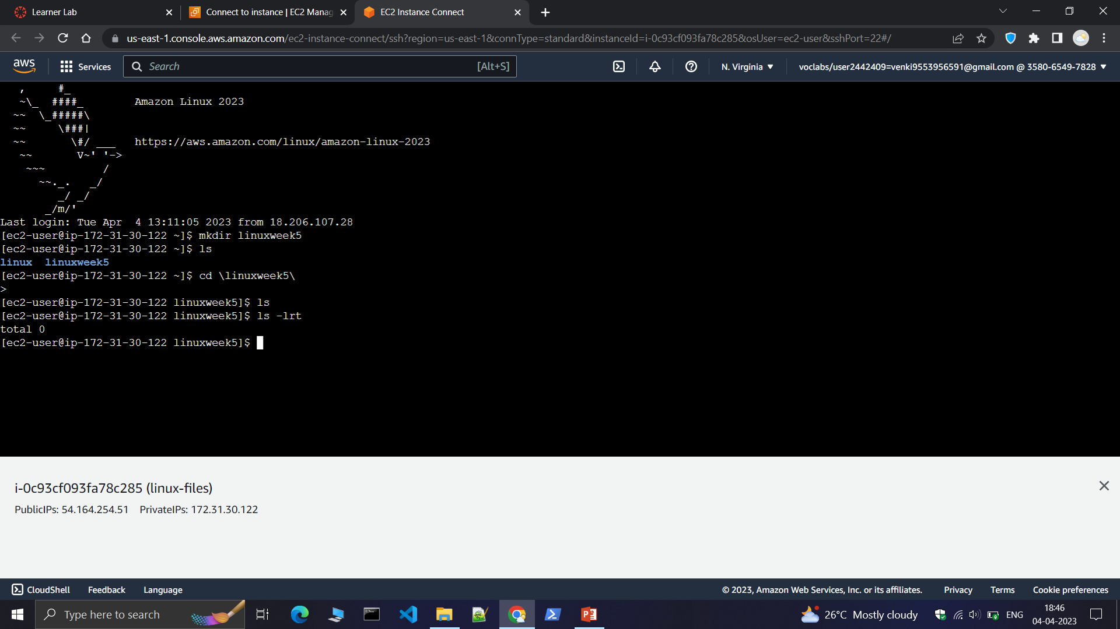
Step3:create a new folder in the linux instance.

Slide 5
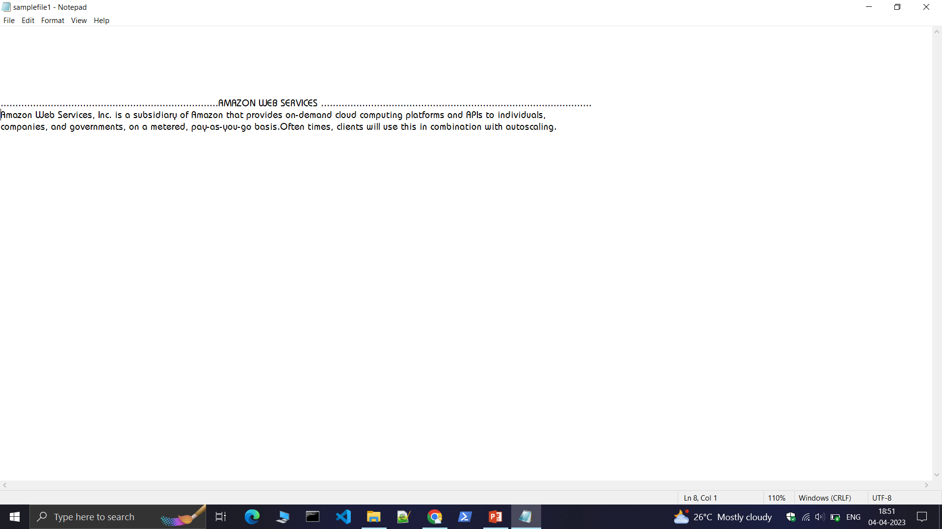
Step3:now come to the local desktop and create a text file as shown below.

Slide 6
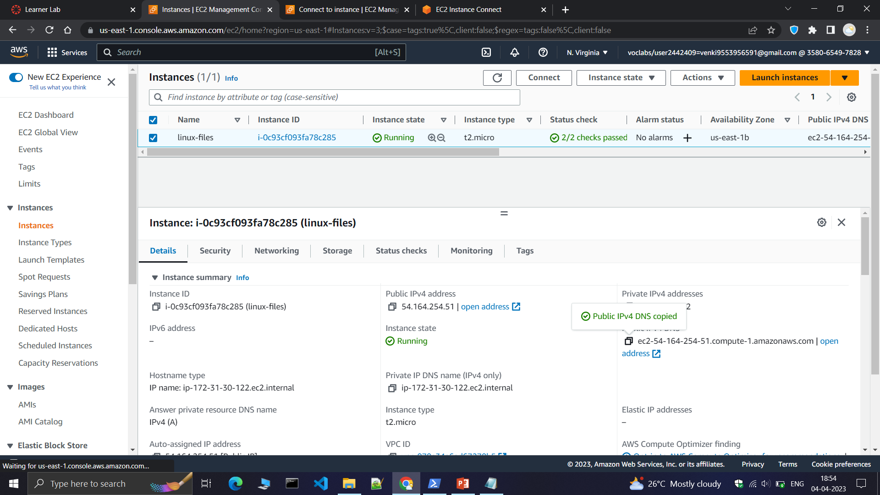
Step5:Copy the IPv4 DNS address of linux instance.

Slide 7
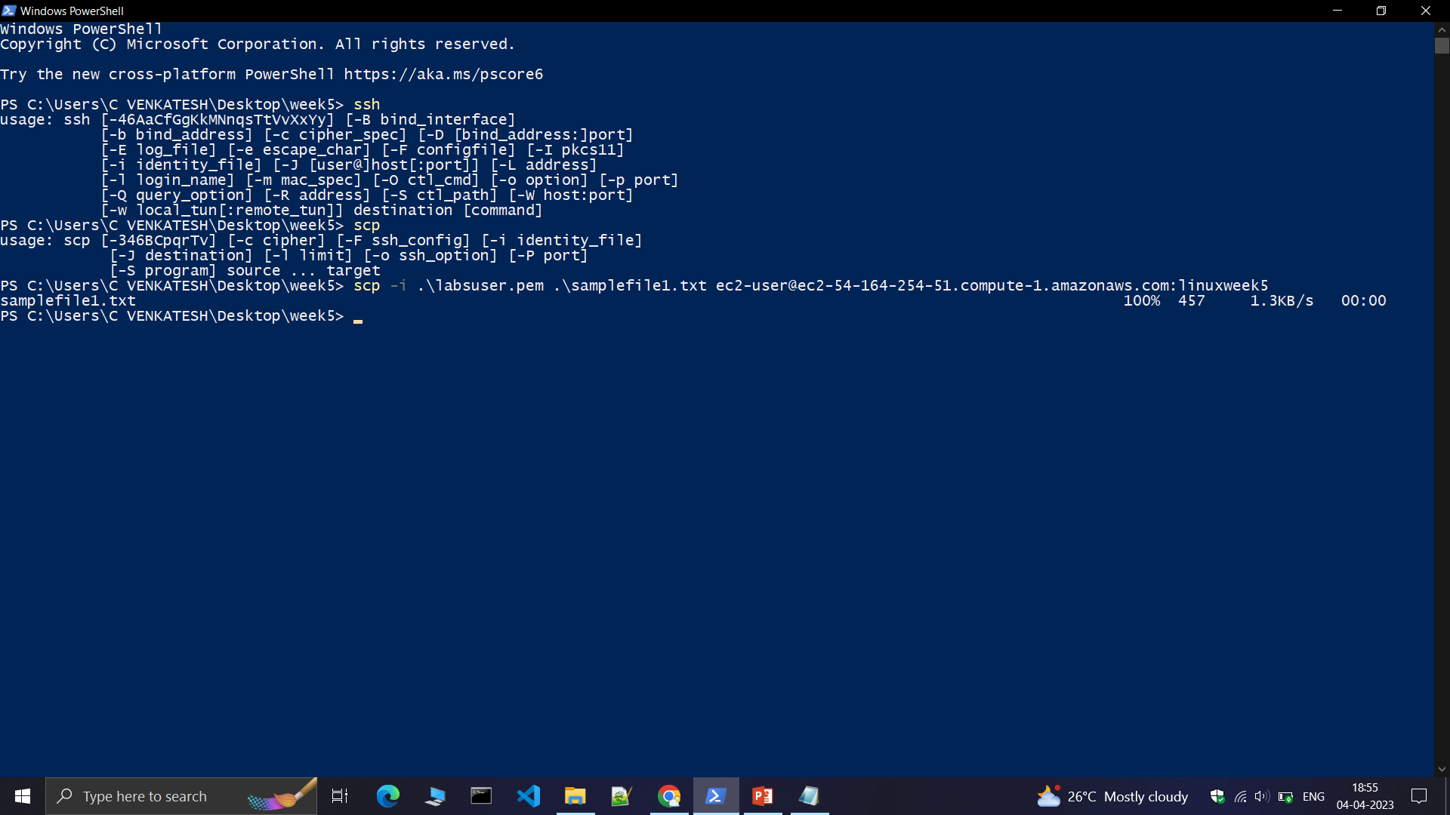
Step6:Now open the powershell in the local desktop and run the series of commands shown below . The text file is uploaded to the ec2 linux instance.

Slide 8
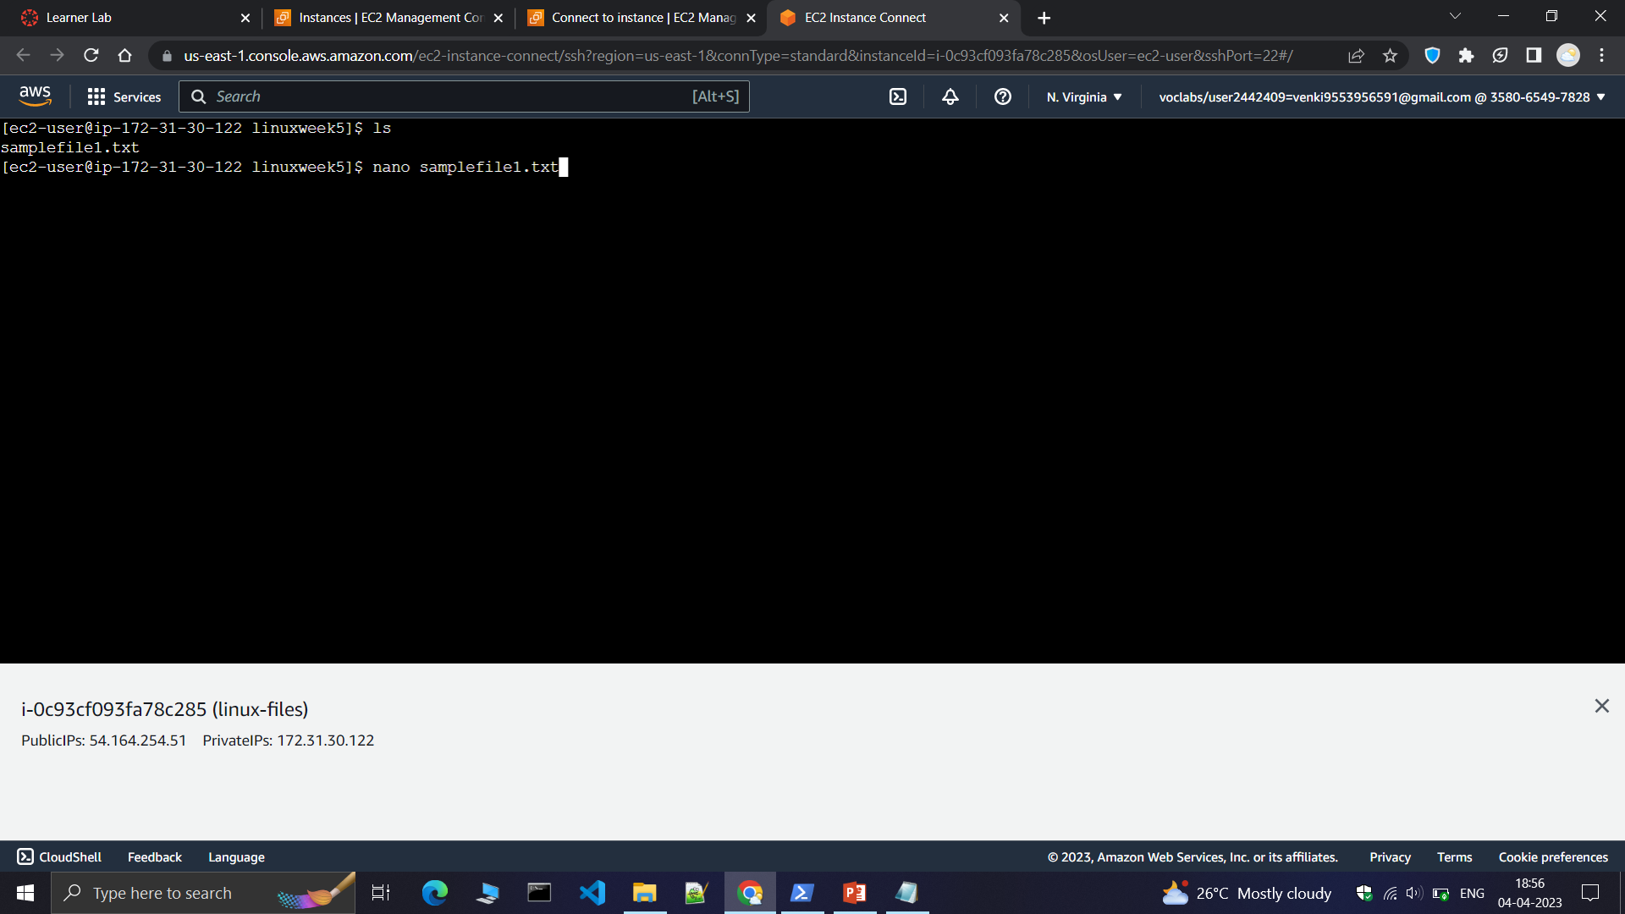
Step7:Now goto the linux instance and open the uploaded text file.

Slide 9
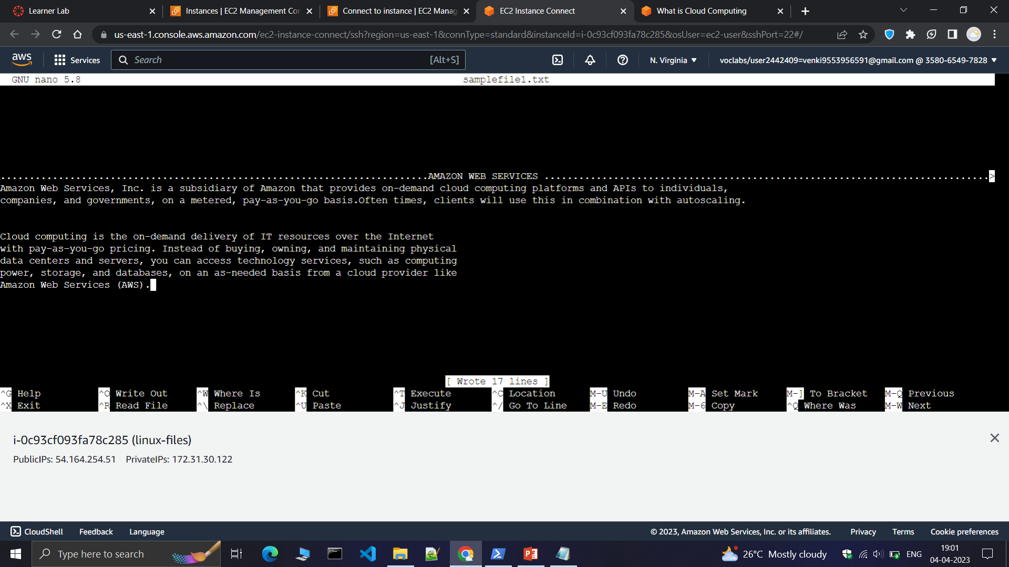
Step8:The uploaded text file from desktop to the linux instance is shown below.

Slide 10
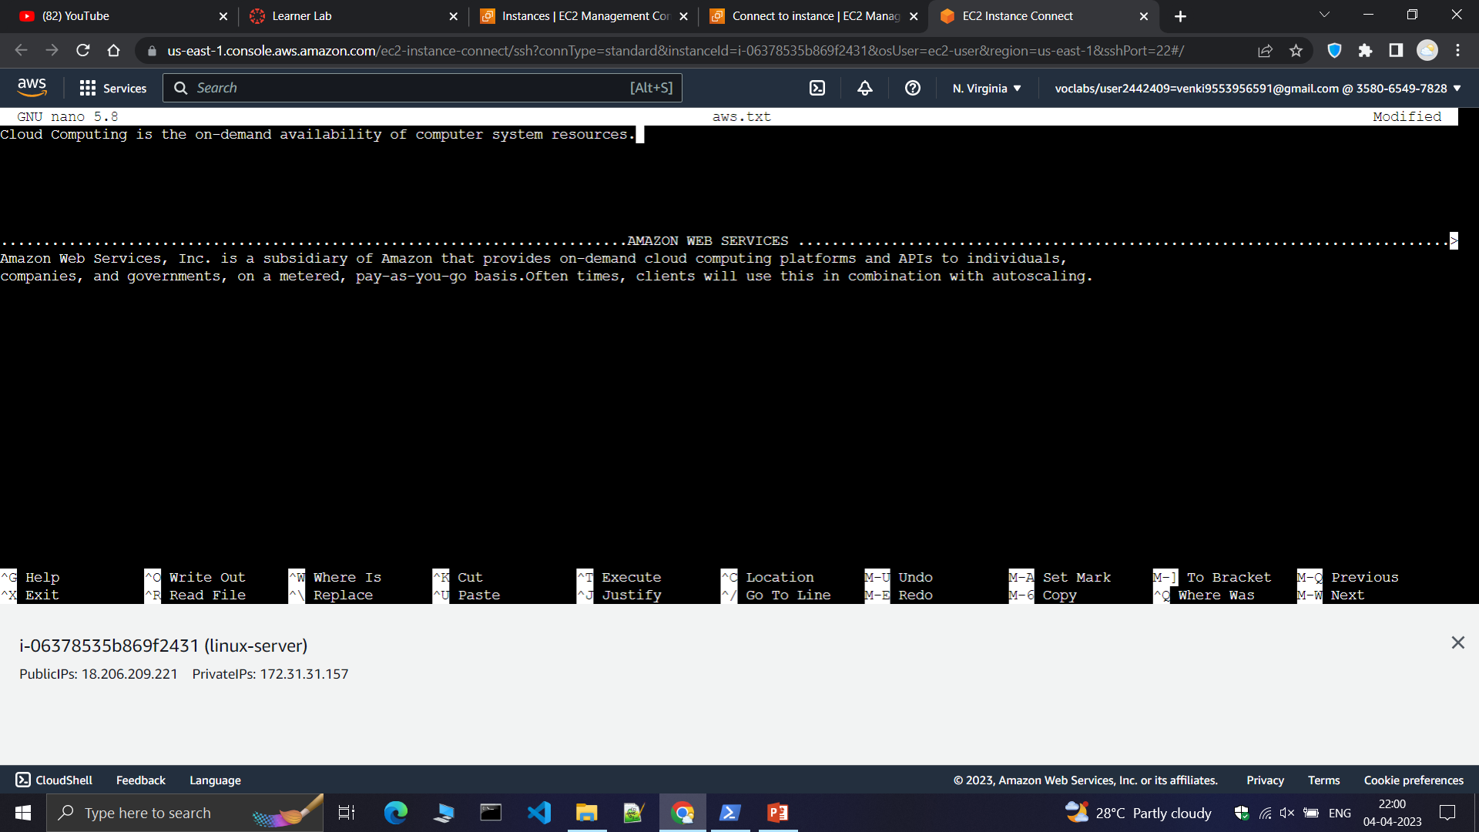
Step9:Now edit the text file.

Slide 11
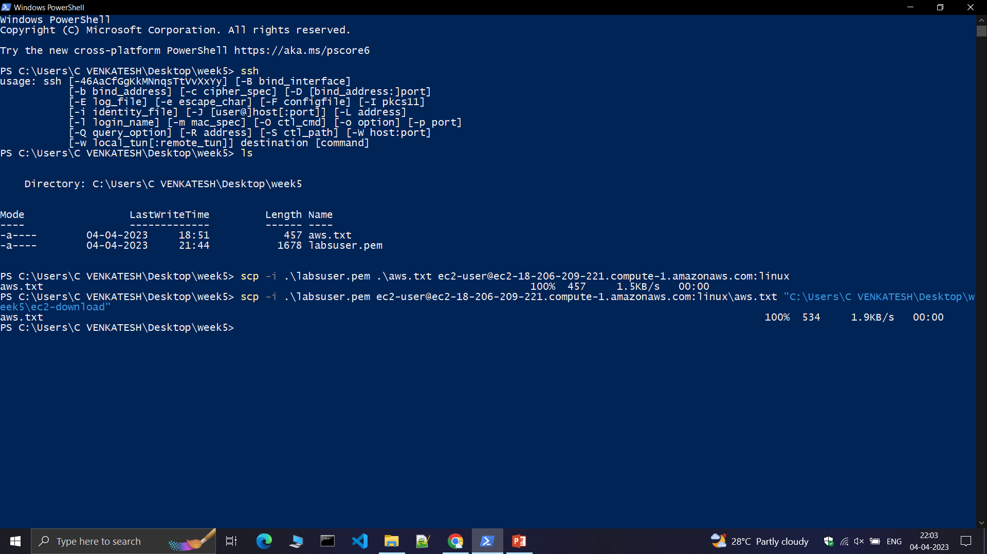
Step10:Now open powershell and run the below commands.

Slide 12
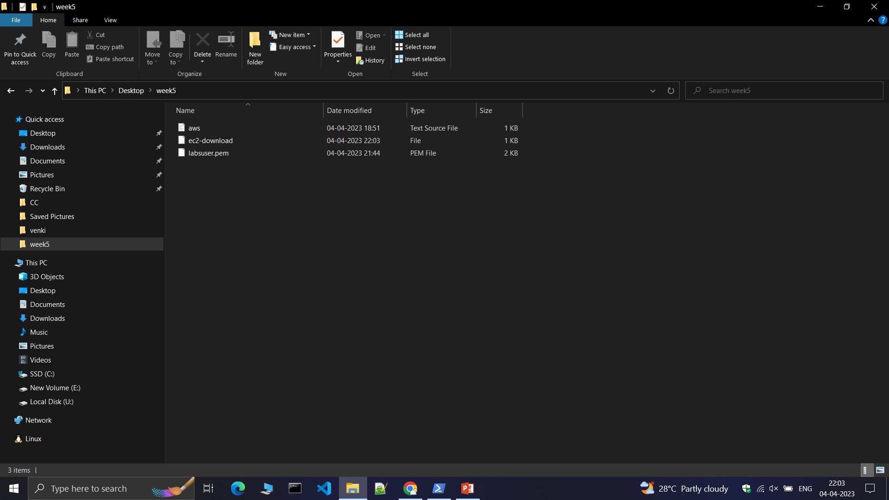
Step12:The file is transferred from ec2 linux instance to the local desktop.

Slide 13
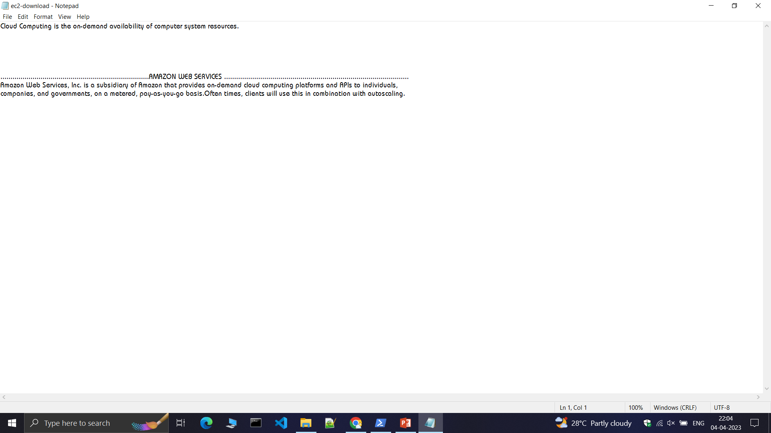
Step12:Open the downloaded file .

